Slide 1
Lecture 15
Core architectural components of Azure
Instructor : Engr. Tehmeed

Slide 2
What is Microsoft Azure
Azure is a continually expanding set of cloud services that help you meet current and future business challenges. Azure gives you the freedom to build, manage, and deploy applications on a massive global network using your favorite tools and frameworks.
Azure provides scalable hosting platforms, where developers can create web based app using popular development frameworks.
The Azure portal lets you create, configure and control all your services and resources from a single easy to use web based interface

Slide 3
What does Azure offer?

Slide 4
What can I do with Azure?
Azure provides more than 100 services that enable you to do everything from running your existing applications on virtual machines to exploring new software paradigms, such as intelligent bots and mixed reality.
Many teams start exploring the cloud by moving their existing applications to virtual machines (VMs) that run in Azure. Migrating your existing apps to VMs is a good start, but the cloud is much more than a different place to run your VMs.
For example, Azure provides artificial intelligence (AI) and machine-learning (ML) services that can naturally communicate with your users through vision, hearing speech. It also provides storage solutions that dynamically grow to accommodate massive amounts of data. Azure services enable solutions that aren't feasible without the power of the cloud.

Slide 5
Get started with Azure accounts
To create and use Azure services, you need an Azure subscription. When you're completing Learn modules, most of the time a temporary subscription is created for you, which runs in an environment called the Learn sandbox. When you're working with your own applications and business needs, you need to create an Azure account, and a subscription will be created for you. After you've created an Azure account, you're free to create additional subscriptions. For example, your company might use a single Azure account for your business and separate subscriptions for development, marketing, and sales departments. After you've created an Azure subscription, you can start creating Azure resources within each subscription.
If you're new to Azure, you can sign up for a free account on the Azure website to start exploring at no cost to you. When you're ready, you can choose to upgrade your free account. You can also create a new subscription that enables you to start paying for Azure services you need beyond the limits of a free account.

Slide 6
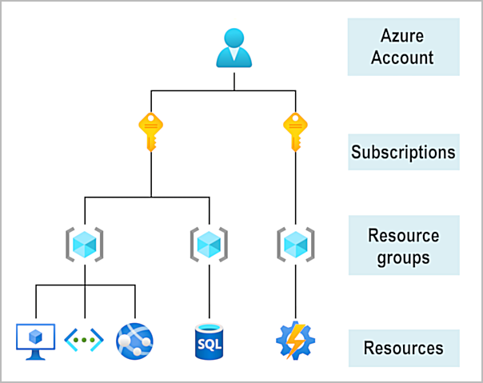
Get started with Azure accounts

Slide 7
What is the Microsoft Learn sandbox?
Many of the Learn exercises use a technology called the sandbox, which creates a temporary subscription that's added to your Azure account. This temporary subscription allows you to create Azure resources during a Learn module. Learn automatically cleans up the temporary resources for you after you've completed the module.
When you're completing a Learn module, you're welcome to use your personal subscription to complete the exercises in a module. However, the sandbox is the preferred method to use because it allows you to create and test Azure resources at no cost to you.

Slide 8
Describe Azure physical infrastructure
Throughout your journey with Microsoft Azure, you’ll hear and use terms like Regions, Availability Zones, Resources, Subscriptions, and more. This module focuses on the core architectural components of Azure. The core architectural components of Azure may be broken down into two main groupings: the physical infrastructure, and the management infrastructure.

Slide 9
Physical infrastructure
The physical infrastructure for Azure starts with datacenters. Conceptually, the datacenters are the same as large corporate datacenters. They’re facilities with resources arranged in racks, with dedicated power, cooling, and networking infrastructure.
As a global cloud provider, Azure has datacenters around the world. However, these individual datacenters aren’t directly accessible. Datacenters are grouped into Azure Regions or Azure Availability Zones that are designed to help you achieve resiliency and reliability for your business-critical workloads.
The Global infrastructure site gives you a chance to interactively explore the underlying Azure infrastructure.

Slide 10
Regions
A region is a geographical area on the planet that contains at least one, but potentially multiple datacenters that are nearby and networked together with a low-latency network. Azure intelligently assigns and controls the resources within each region to ensure workloads are appropriately balanced.
When you deploy a resource in Azure, you'll often need to choose the region where you want your resource deployed.
Note!
Some services or virtual machine (VM) features are only available in certain regions, such as specific VM sizes or storage types. There are also some global Azure services that don't require you to select a particular region, such as Microsoft Entra ID, Azure Traffic Manager, and Azure DNS.

Slide 11
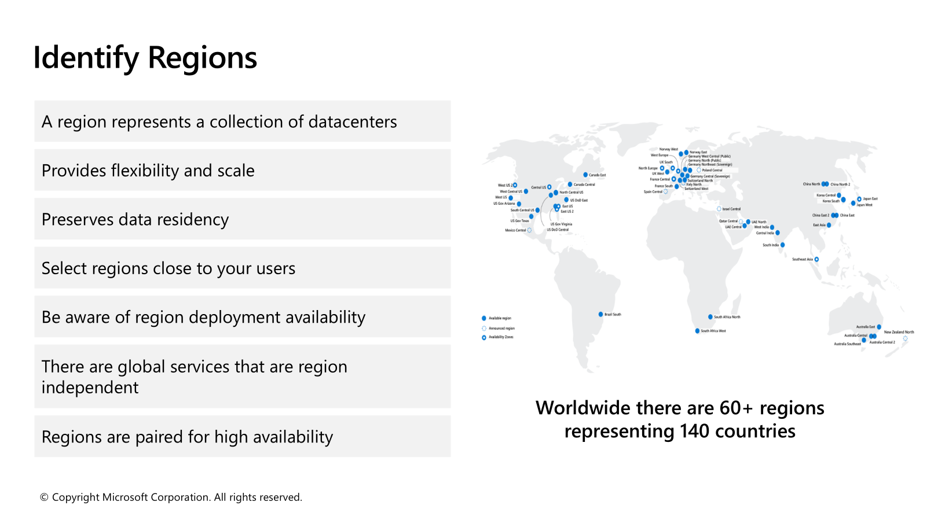

Slide 12
Availability Zones
Availability zones are physically separate datacenters within an Azure region. Each availability zone is made up of one or more datacenters equipped with independent power, cooling, and networking. An availability zone is set up to be an isolation boundary. If one zone goes down, the other continues working. Availability zones are connected through high-speed, private fiber-optic networks.

Slide 13
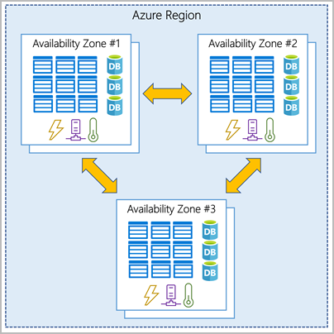
Availability Zones

Slide 14
Use availability zones in your apps
You want to ensure your services and data are redundant so you can protect your information in case of failure. When you host your infrastructure, setting up your own redundancy requires that you create duplicate hardware environments. Azure can help make your app highly available through availability zones.
You can use availability zones to run mission-critical applications and build high-availability into your application architecture by co-locating your compute, storage, networking, and data resources within an availability zone and replicating in other availability zones. Keep in mind that there could be a cost to duplicating your services and transferring data between availability zones.

Slide 15
Use availability zones in your apps
Availability zones are primarily for VMs, managed disks, load balancers, and SQL databases. Azure services that support availability zones fall into three categories:
•Zonal services: You pin the resource to a specific zone (for example, VMs, managed
disks, IP addresses).
•Zone-redundant services: The platform replicates automatically across zones (for
example, zone-redundant storage, SQL Database).
•Non-regional services: Services are always available from Azure geographies and
are resilient to zone-wide outages as well as region-wide outages.
Even with the additional resiliency that availability zones provide, it’s possible that an event could be so large that it impacts multiple availability zones in a single region. To provide even further resilience, Azure has Region Pairs.

Slide 16
Region pairs
Most Azure regions are paired with another region within the same geography (such as US, Europe, or Asia) at least 300 miles away. This approach allows for the replication of resources across a geography that helps reduce the likelihood of interruptions because of events such as natural disasters, civil unrest, power outages, or physical network outages that affect an entire region. For example, if a region in a pair was affected by a natural disaster, services would automatically fail over to the other region in its region pair.
Important!
Not all Azure services automatically replicate data or automatically fall back from a failed region to cross-replicate to another enabled region. In these scenarios, recovery and replication must be configured by the customer.
Examples of region pairs in Azure are West US paired with East US and South-East Asia paired with East Asia. Because the pair of regions are directly connected and far enough apart to be isolated from regional disasters, you can use them to provide reliable services and data redundancy.

Slide 17
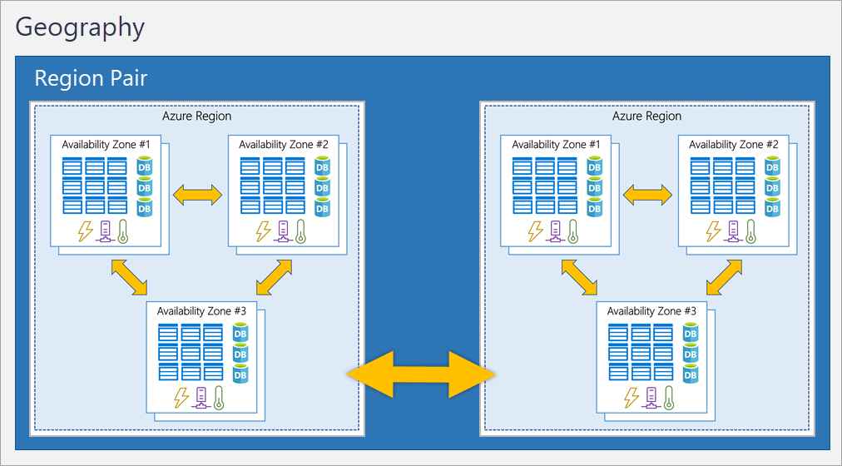
Region pairs

Slide 18
Additional advantages of region pairs:

Slide 19
Sovereign Regions

Slide 20
Manage Costs
Costs are resource-specific
Usage costs may vary between locations
Costs for inbound and outbound data transfers differ
Pre-pay with Azure reserved instances
Use your on-premises licenses with Azure Hybrid Benefit
Optimize with alerts, budgets, and Azure Advisor recommendations
Notes:
Azure usage charges - https://docs.microsoft.com/azure/billing/billing-understand-your-invoice
There are six primary factors affecting costs:
Resource Type: Costs are resource-specific, so the usage that a meter tracks and the number of meters associated with a resource depend on the resource type.
Services: Azure usage rates and billing periods can differ between Enterprise, Web Direct, and CSP customers.
Location: The Azure infrastructure is globally distributed, and usage costs might vary between locations that offer Azure products, services, and resources.
Bandwidth: Some inbound data transfers are free, such as data going into Azure datacenters. For outbound data transfers, such as data going out of Azure datacenters, pricing is based on Zones.
Azure Reservations: Azure Reservations allow you to prepay for one-year or three-years of virtual machine or SQL Database compute capacity. Pre-paying will allow you to get a discount on the resources you use. Azure reservations can significantly reduce your virtual machine or SQL database compute costs — up to 72 percent on pay-as-you-go prices with one-year or three-year upfront commitment. Reservations provide a billing discount and don't affect the runtime state of your virtual machines or SQL databases.
Azure Hybrid Benefit: If you already have Windows Server or SQL Server licenses in your on-premises deployments, you can use the Azure Hybrid Benefit program to save in Azure. With the Windows Server benefit, each license covers the cost of the OS (up to two virtual machines), and you only pay for base compute costs. You can use existing SQL Server licenses to save up to 55 percent on vCore-based SQL Database options. Options include SQL Server in Azure Virtual Machines and SQL Server Integration Services.

Slide 21

Any Questions ?

